Slide 1
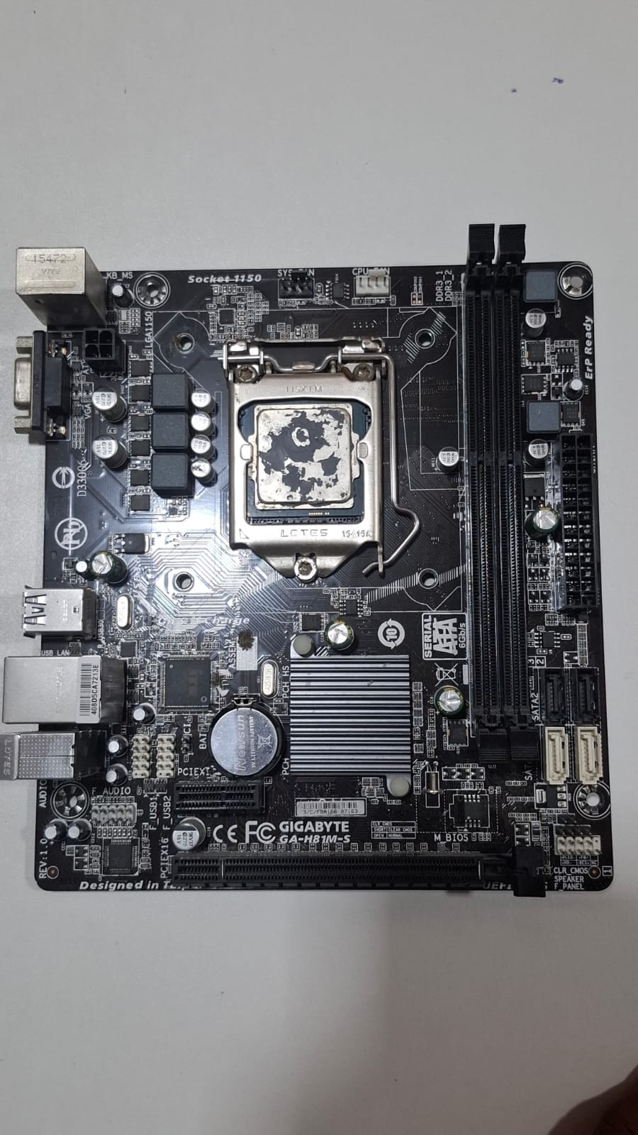
MOTHERBOARD
When you click on a program to open it, the CPU (the brain) sends a message across the Motherboard (the highway) to your Storage (the warehouse). The Storage sends the program's files back across the Motherboard to the RAM (the desk) so the CPU can use it quickly. The Motherboard makes sure everyone gets the data and power they need instantly.

Slide 2
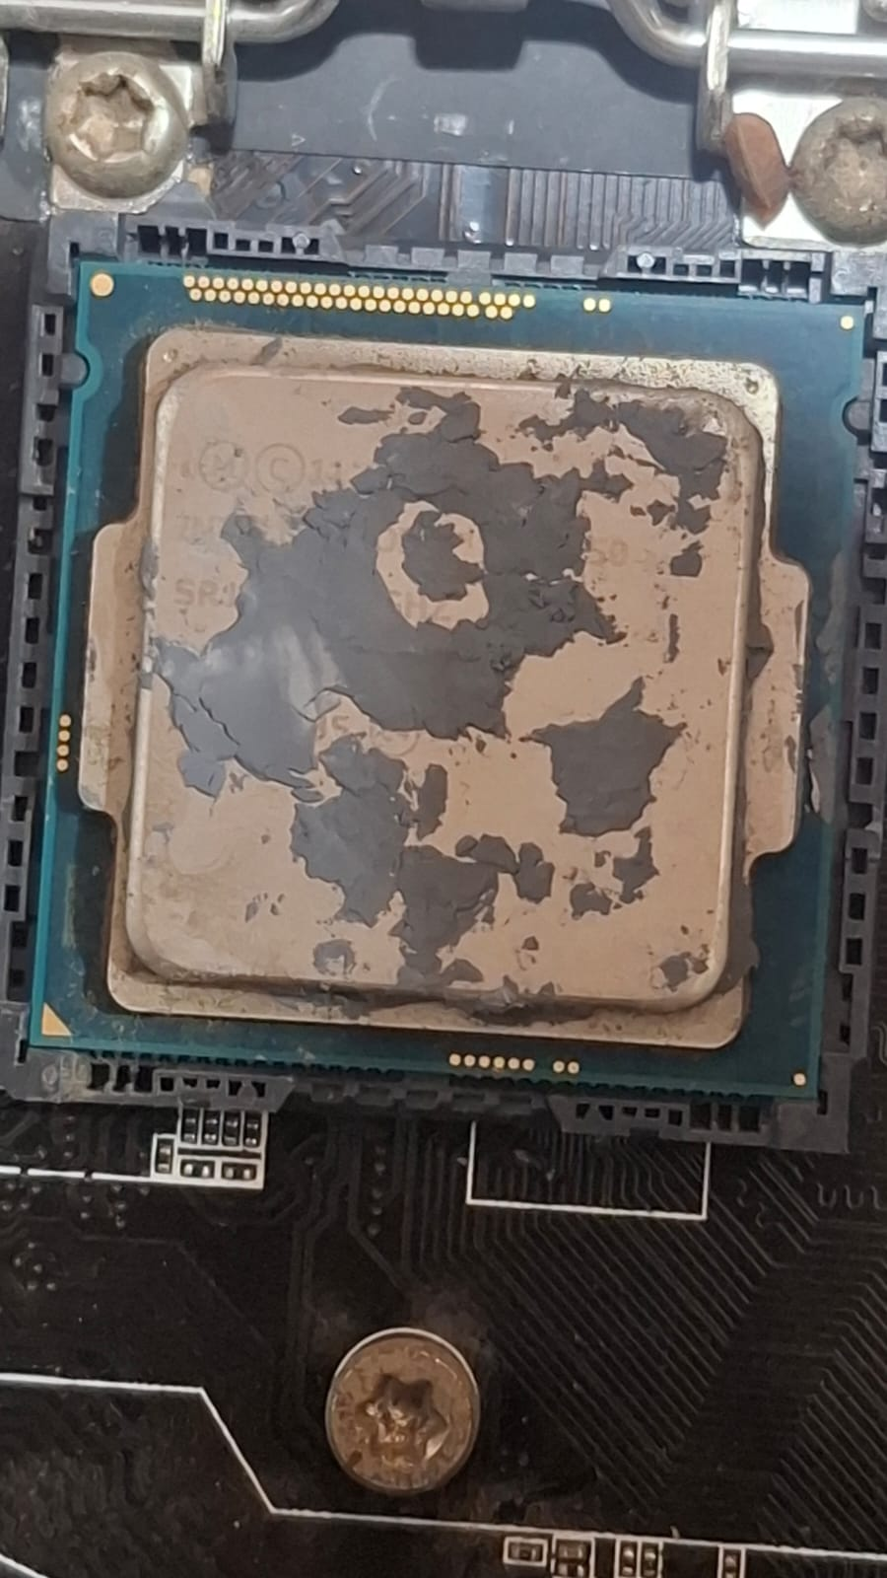
CPU
The CPU / Processor (The Mayor): This is the "brain" of the computer that gives the orders. In your photo, this is the square silver chip right in the middle (yours currently has some dried thermal paste on it!).

Slide 3
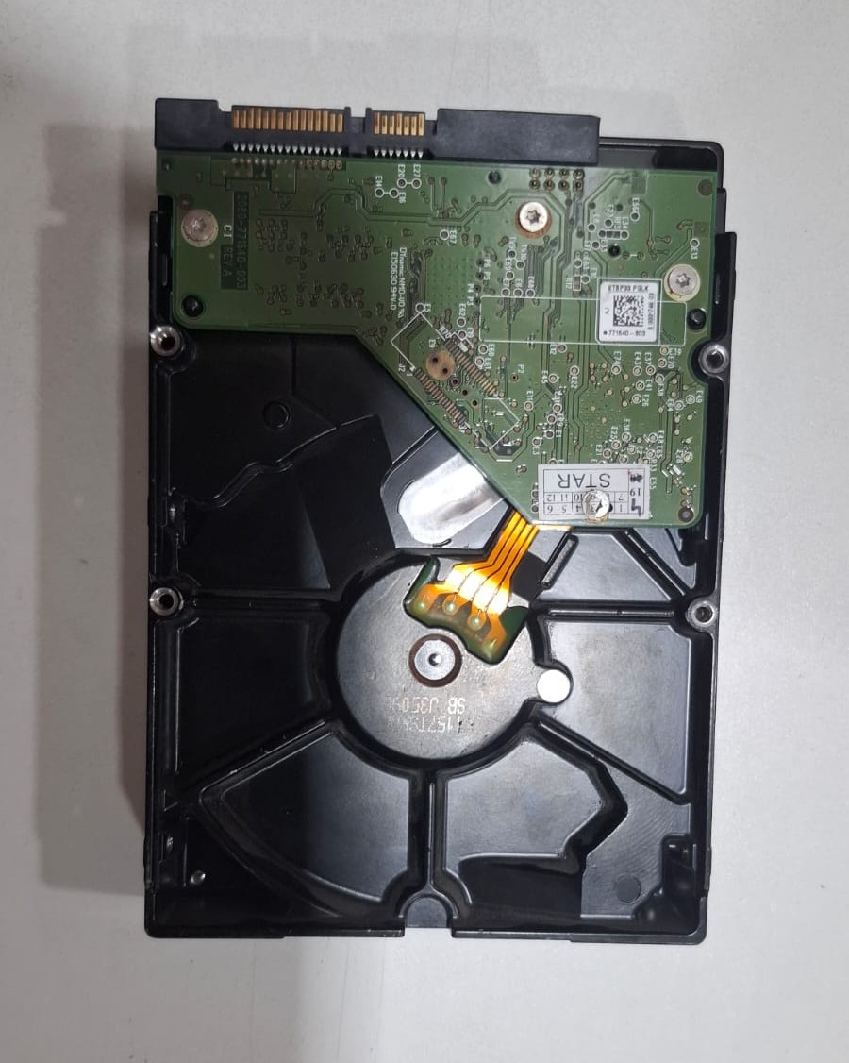
HDD
An HDD (Hard Disk Drive) is like your computer’s permanent digital storage room—it slowly reads and writes your files onto spinning magnetic platters, safely keeping all your photos, games, and software saved even when the computer is turned completely off.

Slide 4
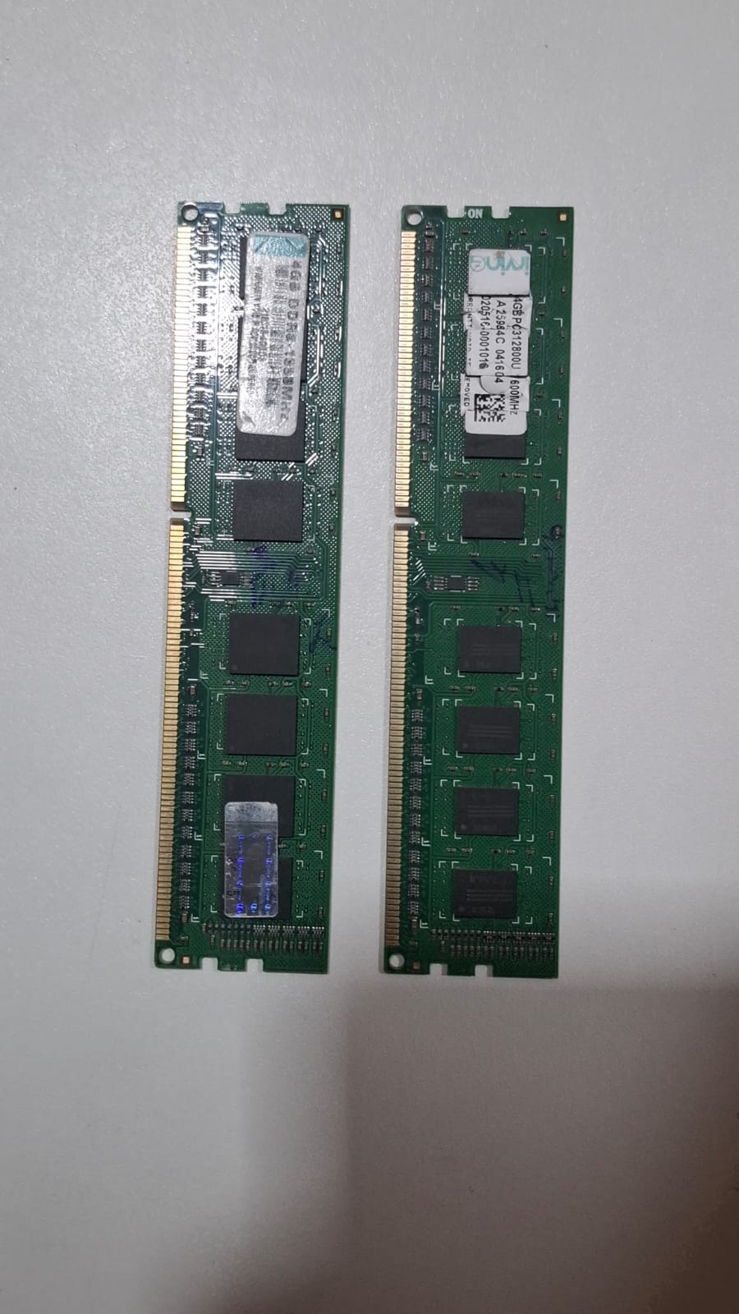
RAM
RAM (Random Access Memory) is your computer's temporary, super-fast workspace that holds the data and programs the CPU is actively using right now, but it clears completely every time the computer is turned off.

Slide 5
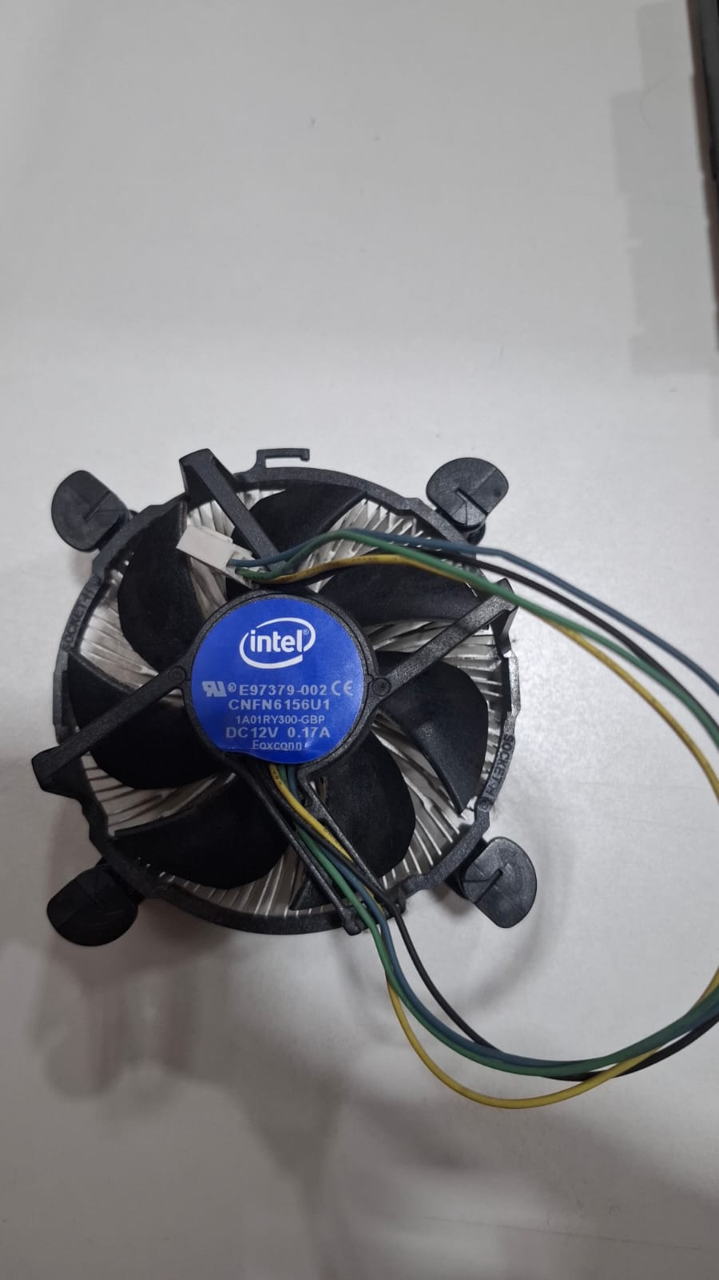
CPU FAN
A CPU fan is like a mini air conditioner that sits directly on top of your computer's brain to cool it down and prevent it from overheating while it works hard.

Slide 6
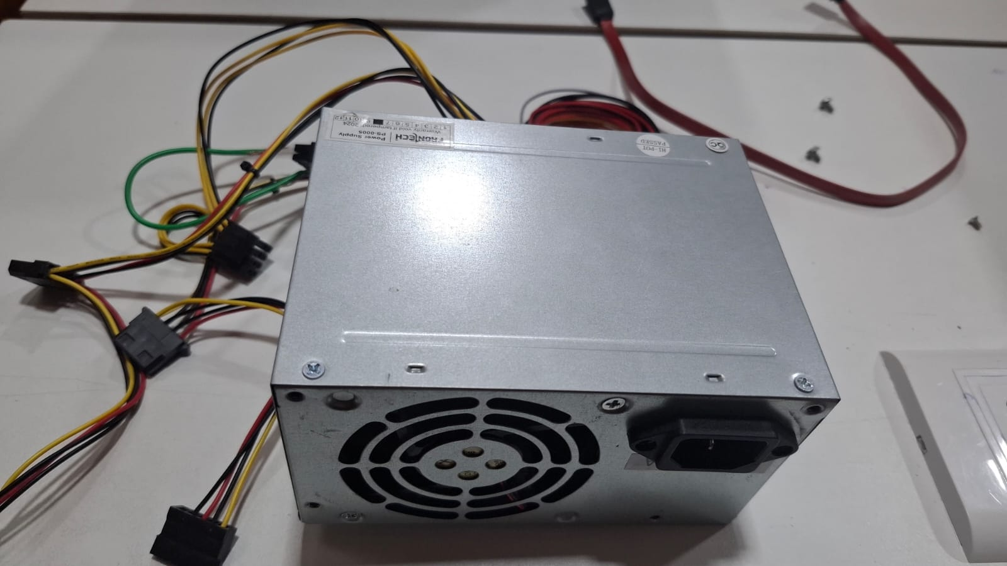
SMPS
An SMPS (Switched-Mode Power Supply) is like your computer's personal transformer—it takes the strong, high-voltage electricity from your wall outlet and carefully converts it into the safe, steady, low-voltage power that your delicate computer parts need to run.

